Slide 1
Gym Manager

Slide 2
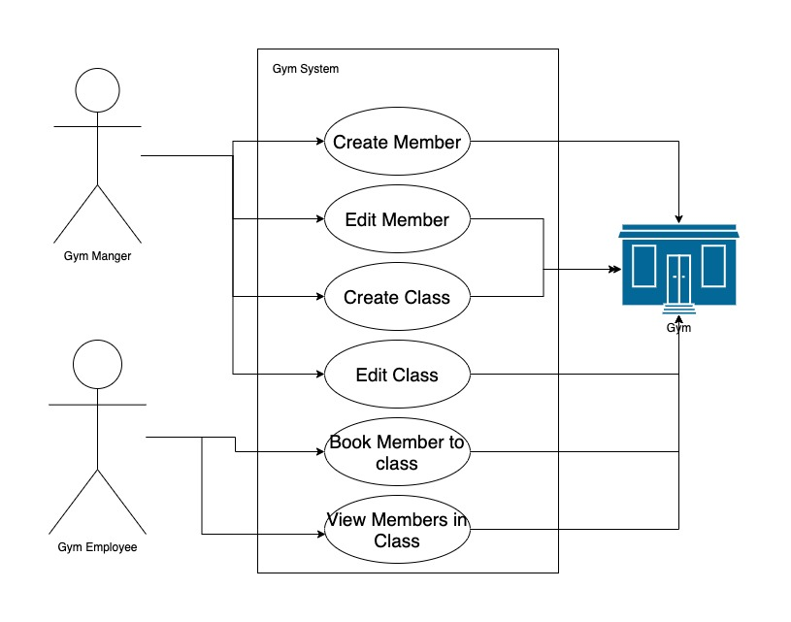
Case Diagram

Slide 3
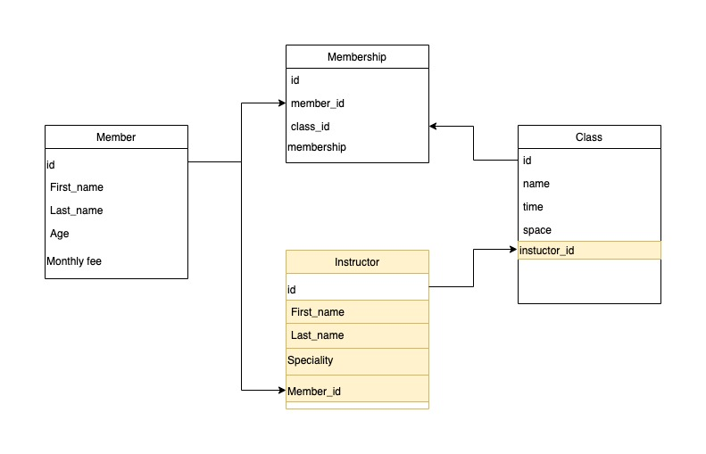
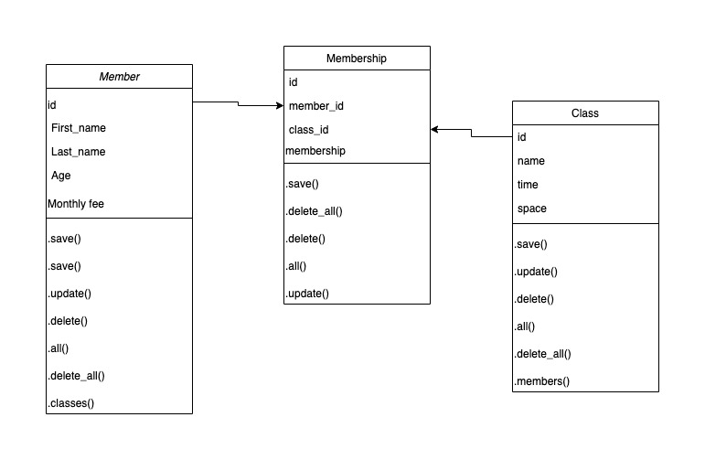
Class Diagram
Notes:
Monthly fee membership class
Working only with 3 tables
Class needs an instructor

Slide 4
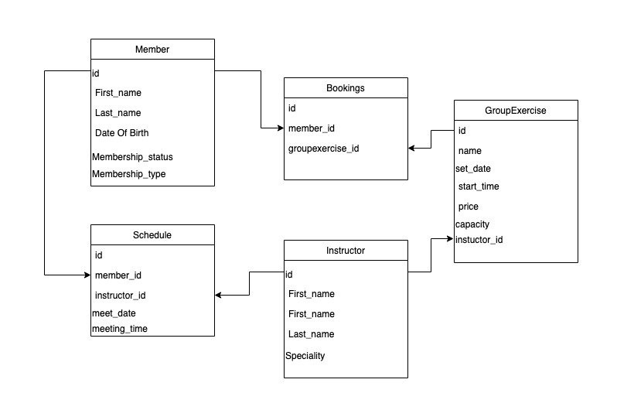
Notes:
Add schedle member many instructors
Member books a class
Membership type

Slide 5
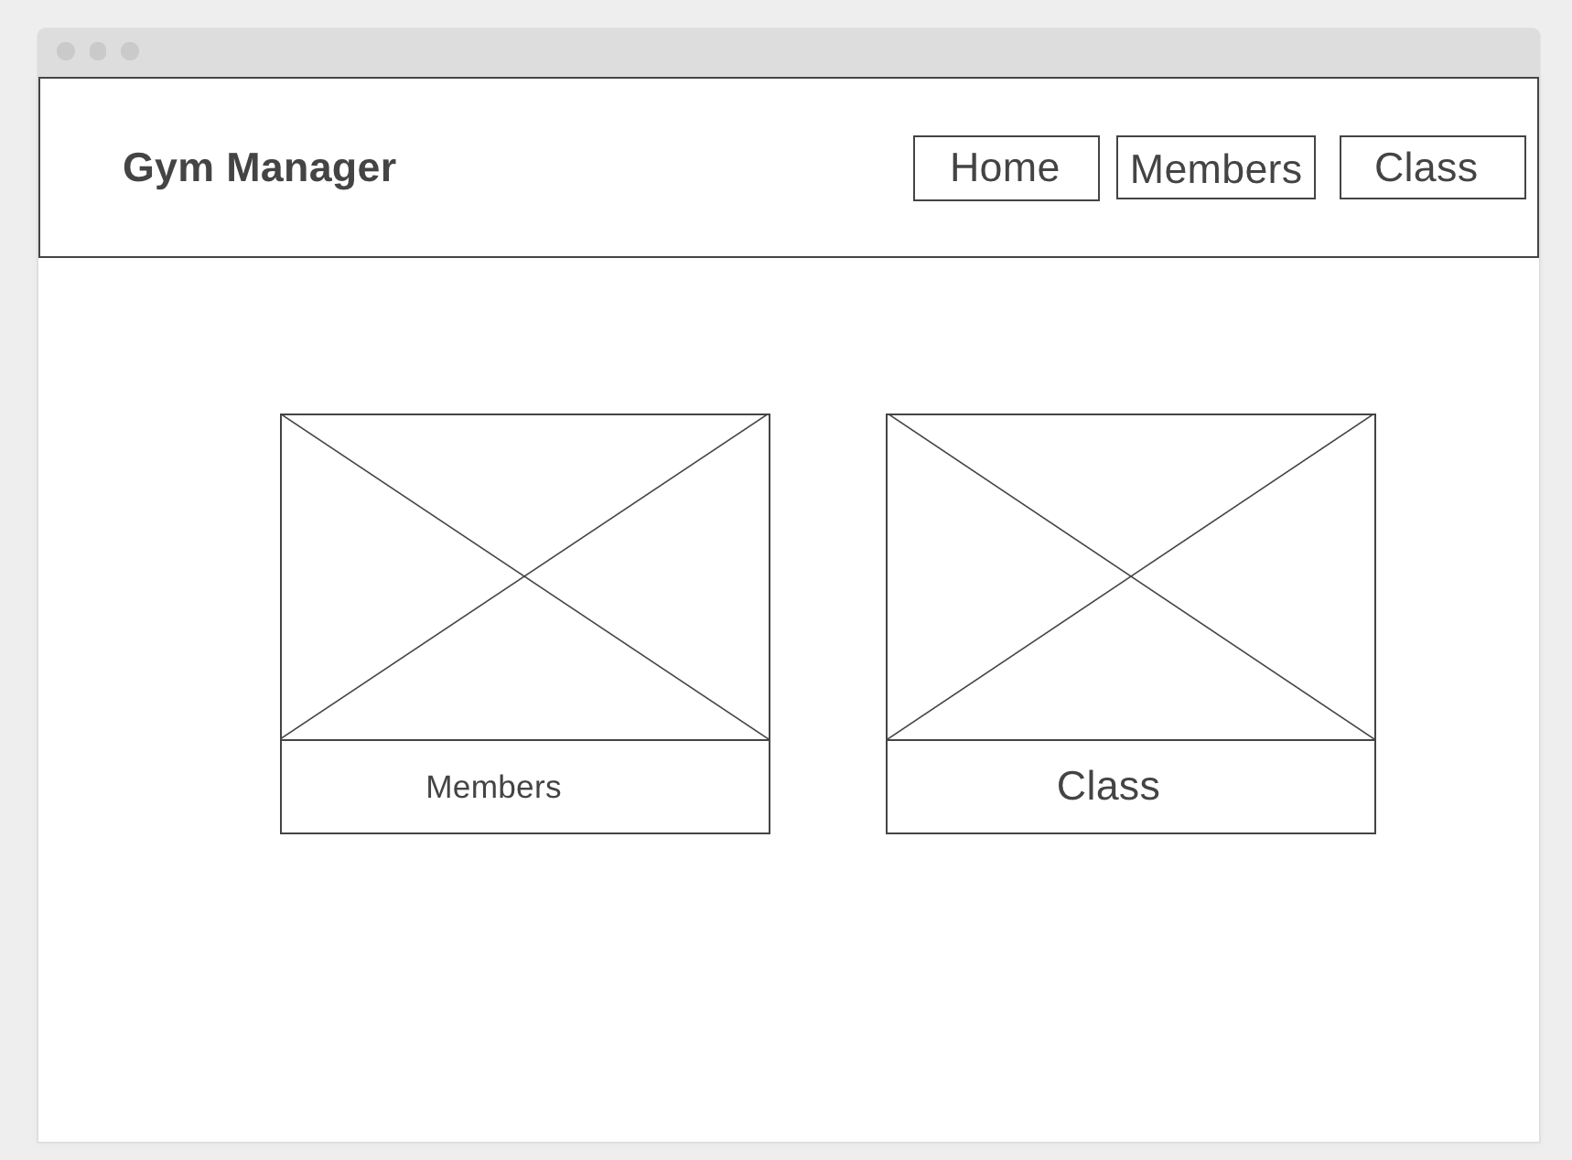
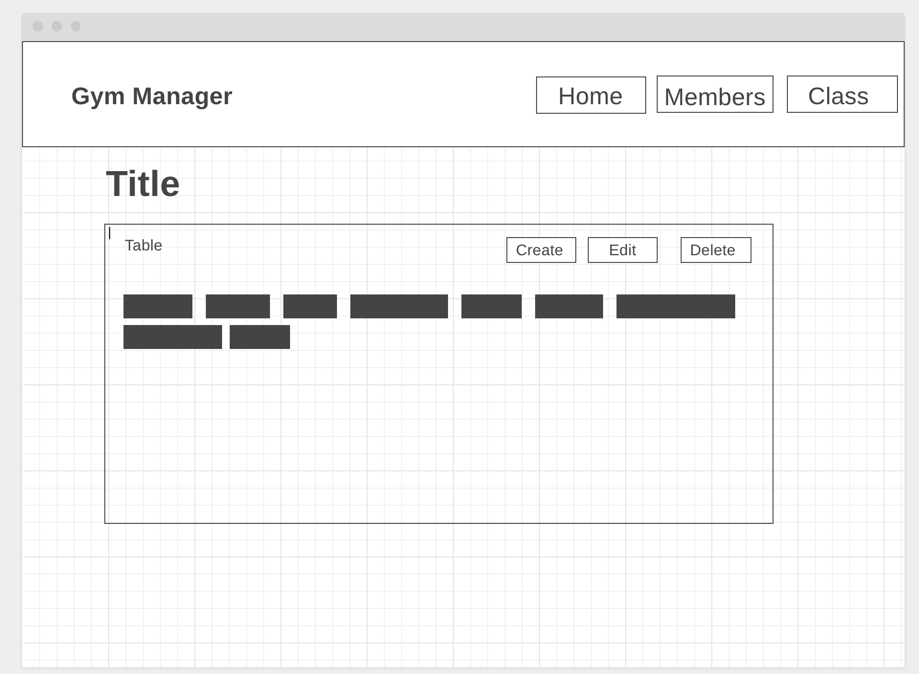
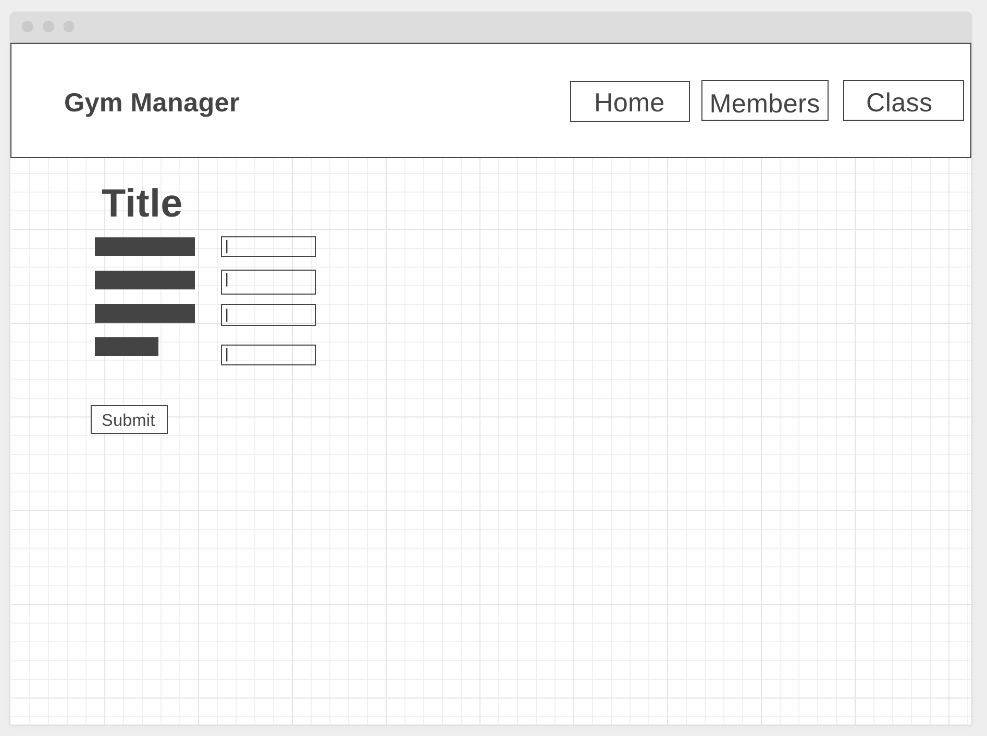
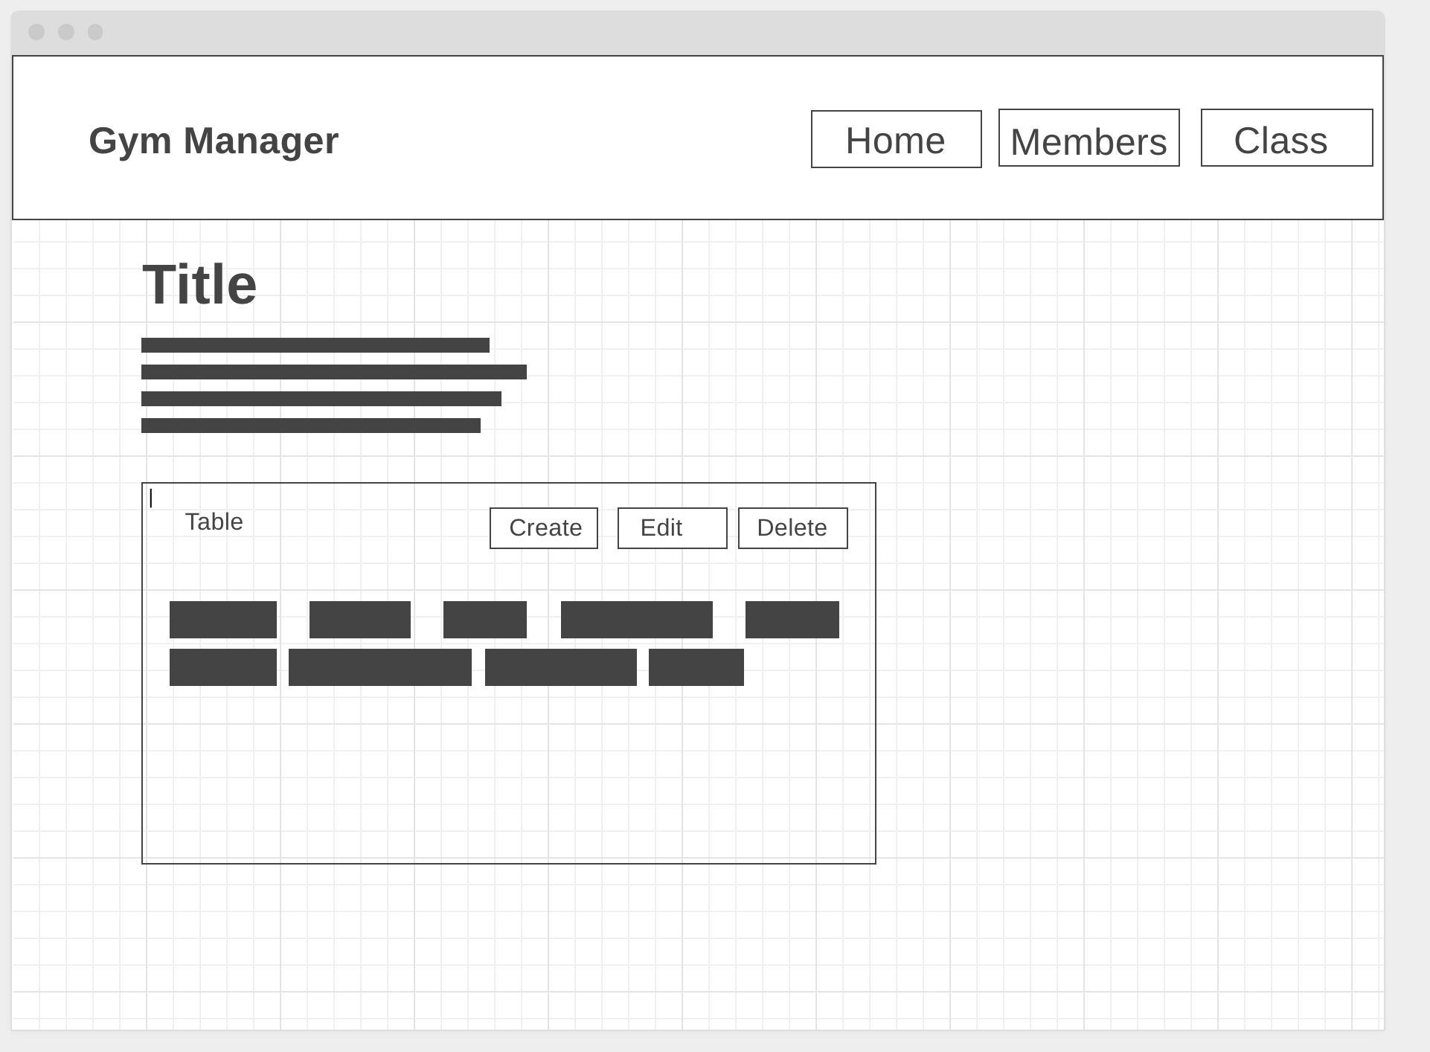
Wireframe
Home
Index
new/ edit
Show

Slide 6
Demo

Slide 7
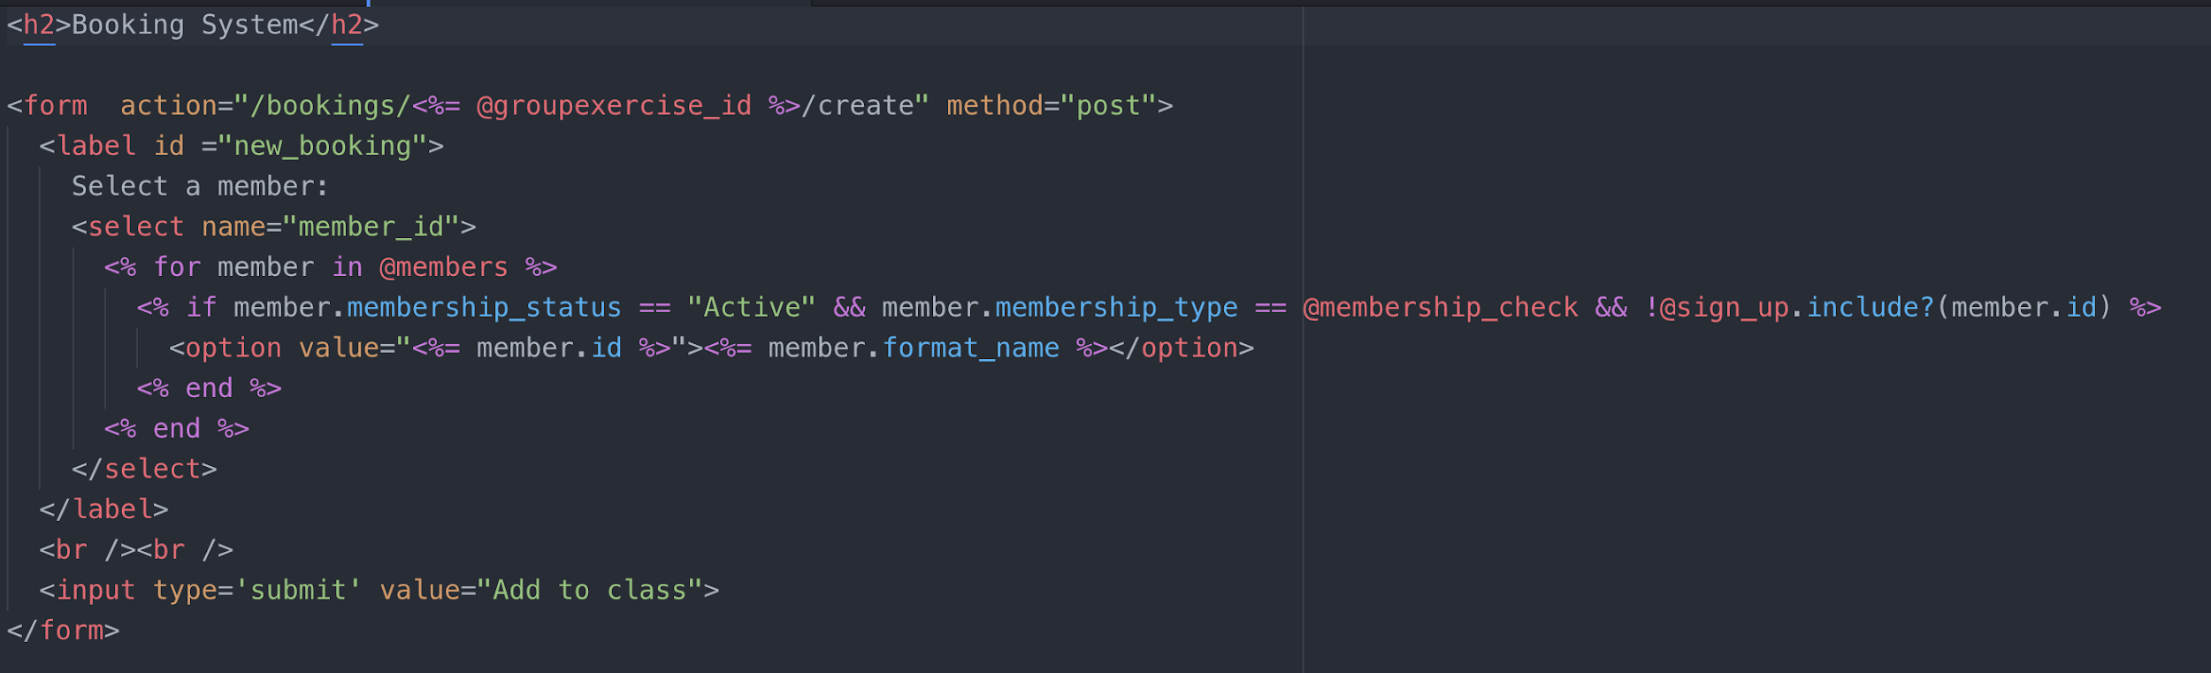
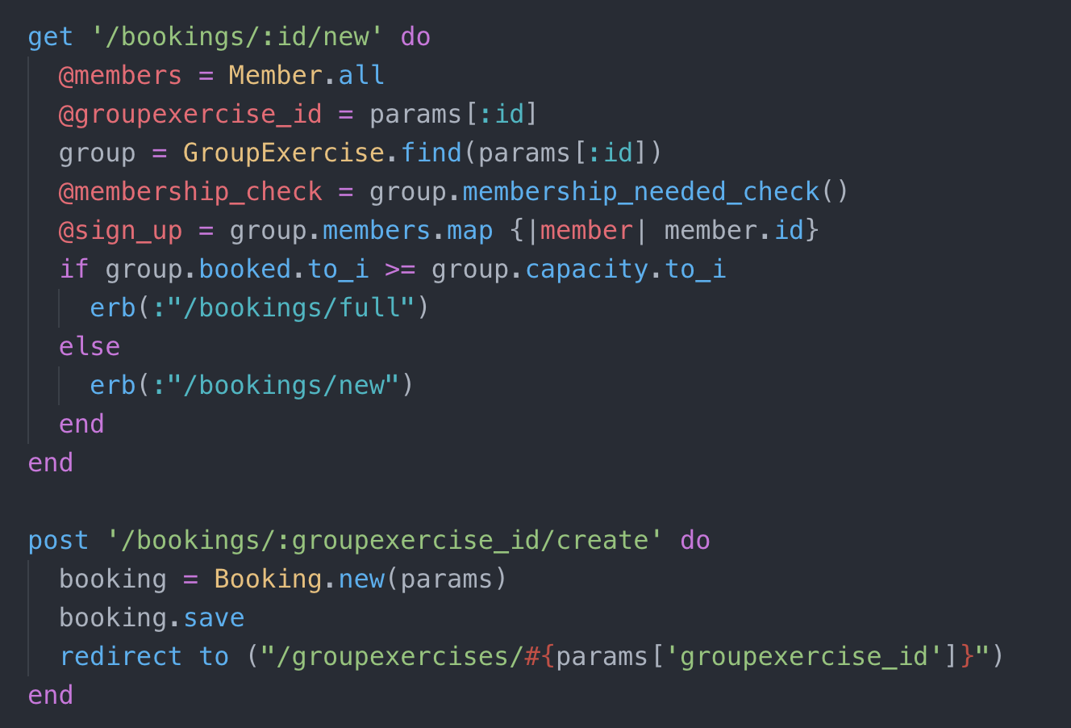
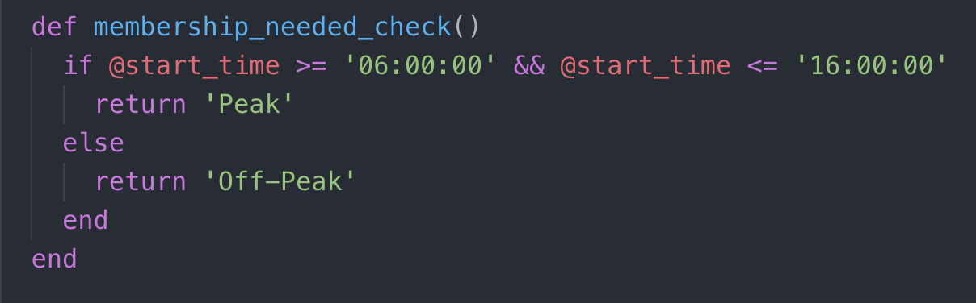
Notes:
maximum capacity,
Premium or Standard membership
active/deactivated
Books
passes

Slide 8
Continuation:
3 more personal extensions - add profile pictures, monthly fee
Responsive page
Look at accessibility- hyperlinks not obvious
More view/filters - day/week/month
More buttons!!!!
Notes:
Finance be able to add up monthly fee class and instructor
Assign work outs to
Add profile pic
Partly resposive
nav be pictures
Hamburger
Day view with times on the side
Week
Month
Tuesday buttons

Slide 9
Things I learned:
Need to plan more - wireframes
Scope of project- what is possible in a week
I’m still a night owl
Always leave time for bug fixes
Notes:
Plan more monday add dates
Buttons
Bugs
views

Slide 10
Questions???

